Slide 1




KS4 Mathematics
S2 Pythagoras’ Theorem

Slide 2

Right-angled triangles
A right-angled triangle contains a right angle.
The longest side opposite the right angle is called the hypotenuse.
Notes:
Review the definition of a right-angled triangle.
Tell pupils that in any triangle the angle opposite the longest side will always be the largest angle and vice-versa.
Ask pupils to explain why no other angle in a right-angled triangle can be larger than or equal to the right angle.
Ask pupils to tell you the sum of the two smaller angles in a right-angled triangle.
Recall that the sum of the angles in a triangle is always equal to 180°. Recall, also, that two angles that add up to 90° are called complementary angles. Conclude that the two smaller angles in a right-angled triangle are complementary angles.

Slide 3
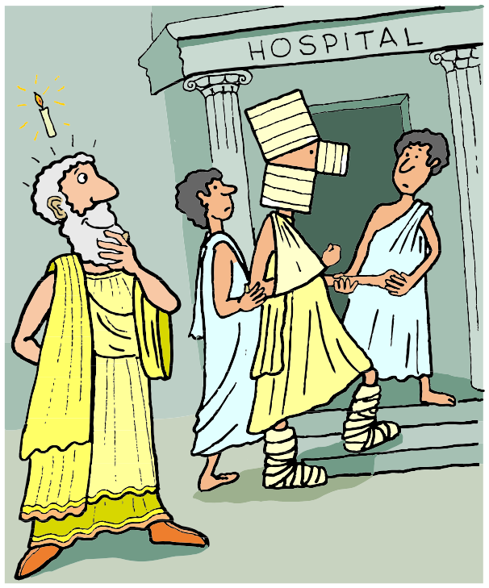
The history of Pythagoras’ Theorem
Pythagoras’ Theorem concerns the relationship between the sides of a right angled triangle.
The theorem is named after the Greek mathematician and philosopher, Pythagoras of Samos.
Although the Theorem is named after Pythagoras the result was known to many ancient civilizations including the Babylonians, Egyptians and Chinese, at least 1000 years before Pythagoras was born.
Notes:
Explain that the theorem is named after Pythagoras because he, or a member of his society, was the first person known to have formally proven the result.

Slide 4
Pythagoras’ Theorem
Pythagoras’ Theorem states that the square formed on the hypotenuse of a right-angled triangle …
… has the same area as the sum of the areas of the squares formed on the other two sides.
Notes:
Pythagoras’ Theorem may be expressed as a relationship between areas, as shown here, or a relationship between side lengths.
In fact, the area of any similar shapes may by drawn on the sides of a right-angled triangle. The area of the shape drawn on the hypotenuse, will be equal to the sum of the areas of the shapes drawn on the two shorter sides.
See S9.4 Circles for a problem involving the areas of semi-circles drawn on the sides of a right-angled triangle.

Slide 5
Pythagoras’ Theorem
If we label the length of the sides of a right-angled triangle a, b and c as follows,
then the area of the largest square is c × c or c².
c²
The areas of the smaller squares are a² and b².
a²
c
a
We can write Pythagoras’ Theorem as
b
b²
c² = a² + b²
Notes:
This slide shows how Pythagoras’ Theorem can be written as a relationship between the side lengths of a triangle with sides a, b and c, where c is the hypotenuse.
Ask pupils to tell you what a² is equal to. (c² – b²).
Ask pupils to tell you what b² is equal to. (c² – a²).

